Slide 1
Born-Again Neural Networks
Teacher和student相同的情况下，student（BAN）的性能明显优于teacher
探讨了teacher如何影响BAN

Slide 2
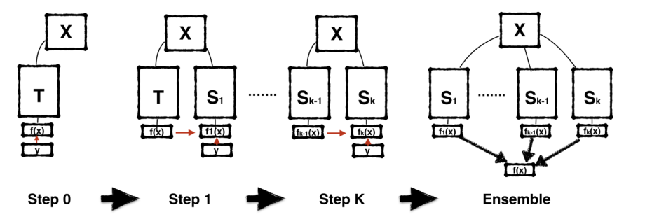
BAN训练流程
用label训练teacher模型T，直至收敛
用不同的random seed初始化一个相同的模型，并且在前代的监督下训练
重复2
（可选）最终对多代的students进行ensumble

Slide 3
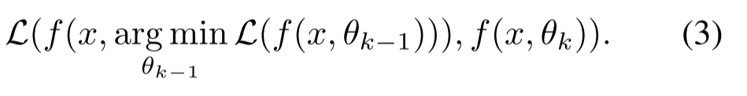
BAN训练细节
loss function
即teacher/前代student输出和student输出之间的交叉熵

Slide 4
实验
数据集：CIFAR-10/100
DenseNets（depth, growth, and compression factors）
Wide-ResNet (Zagoruyko & Komodakis, 2016b)

Slide 5
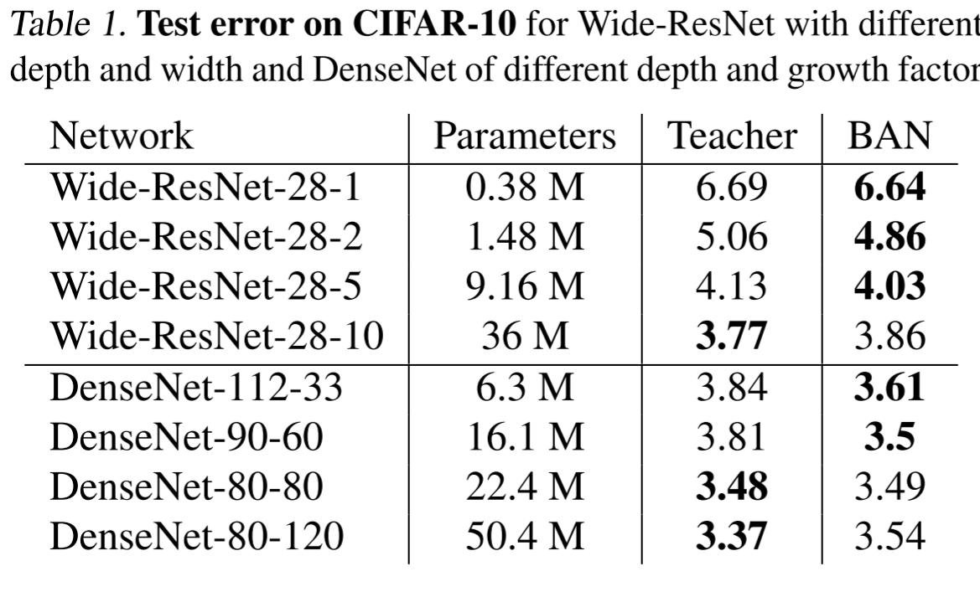
CIFAR-10
不同复杂度(参数量)的架构之间的差距缩小

Slide 6
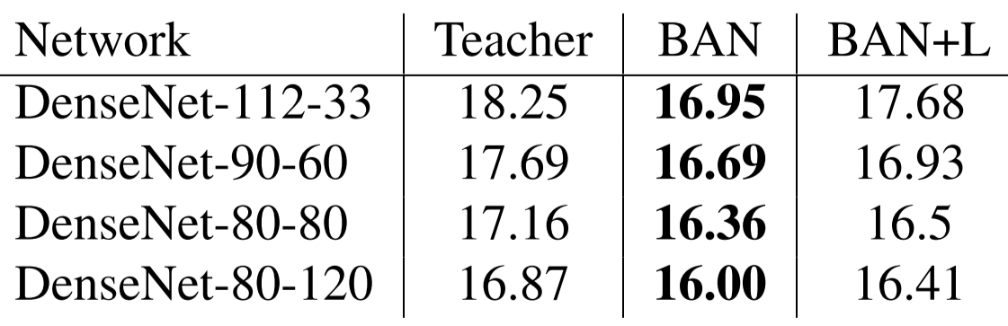
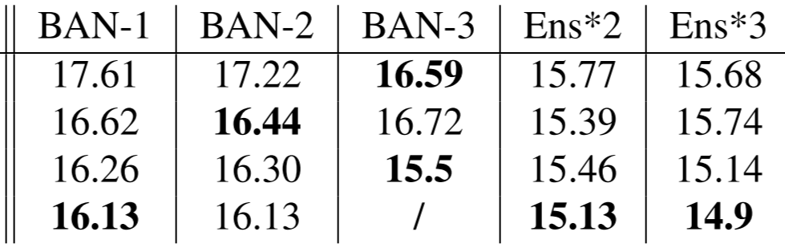
CIFAR-100
BAN+L = teacher loss + label loss
BAN和Teacher
小模型与大模型之间的差距缩小
BAN-1到BAN-3

Slide 7
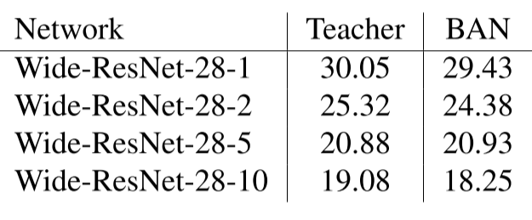
CIFAR-100
Wide-ResNet (Zagoruyko & Komodakis, 2016b)

Slide 8
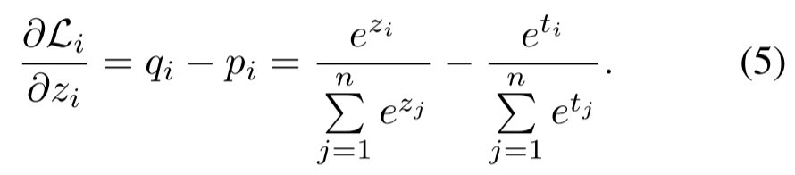
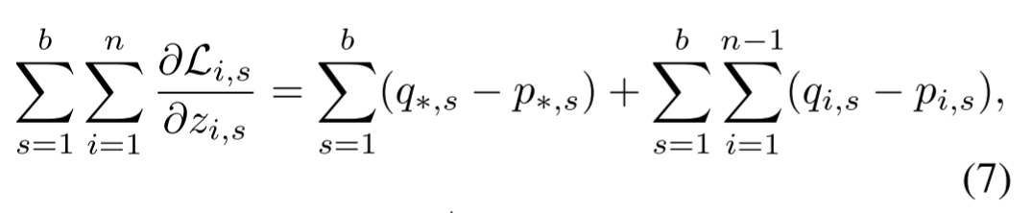
Teacher对BAN的影响
loss function
令z表示student logits，t表示teacher logits
b个样本的mini-batch求偏导，*代表ground truth label，假设第n个label是ground truth

Slide 9
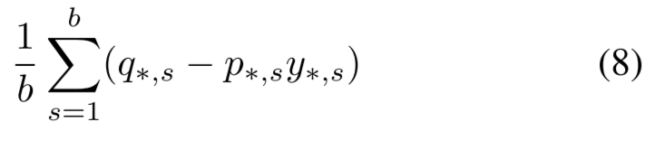
第一项对应correct choice的信息，第二项对应所有wrong outputs的信息
gradient from the correct choice可以被重写为：
teacher输出p*就是ground truth label y*的一个权重
KD的成功来自于哪里？
如Hinton所说的，wrong answer隐含了一些类别相似性的信息（第二项）
teacher做了类似于样本重要性加权的工作（第一项）

Slide 10
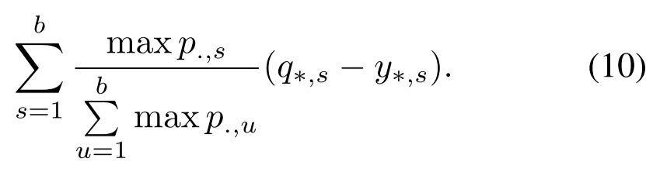
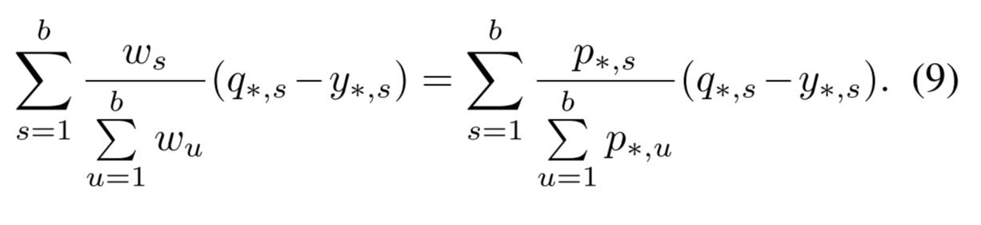
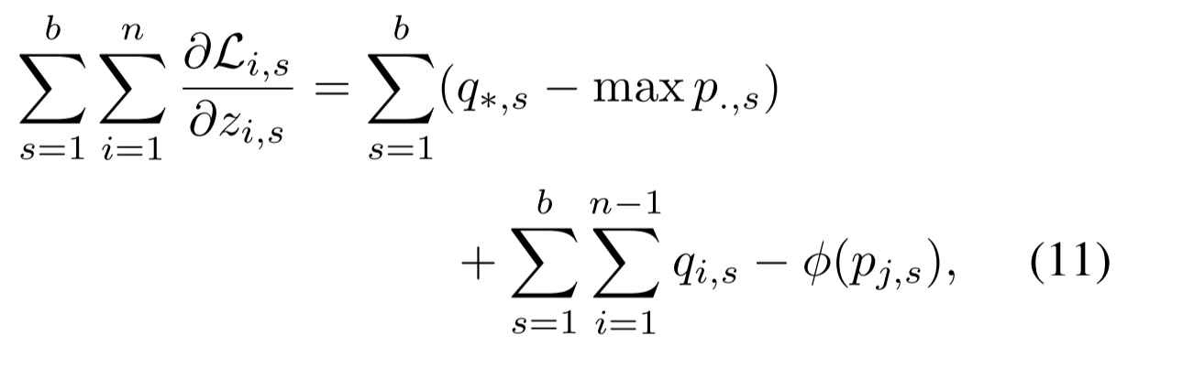
CWTM和DKPP
Confidence Weighted by Teacher Max (CWTM)
Permuted Predictions (DKPP)

Slide 11
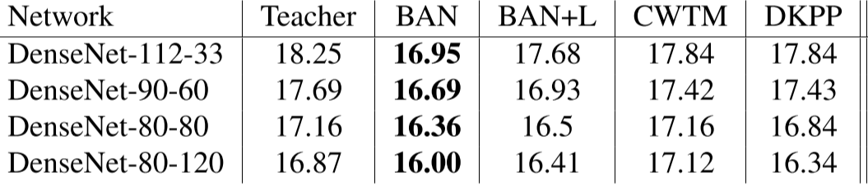
实验结果
CWTM和DKPP处理有，和teacher对比基本上都有微弱提升
CWTM对Teacher的微弱提升说明预训练模型包含的信息可以用来重新平衡训练集
DKPP对Teacher的提升说明non-argmax label可能不是那么重要

Slide 12
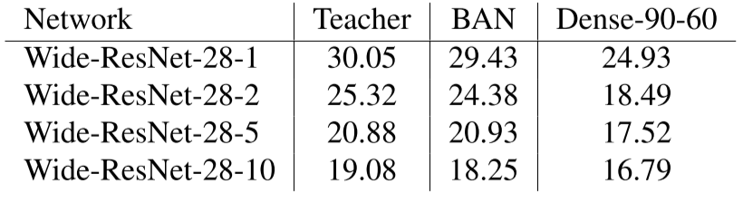
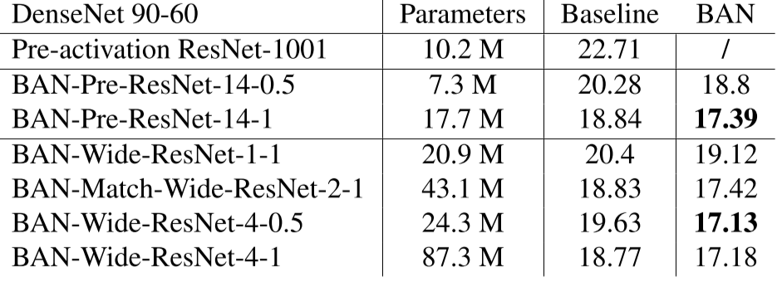
其他实验（Teacher与Student不同）
CIFAR-100
Teacher: Wide-ResNet, student: DenseNets
Teacher: DenseNets, student:ResNets

Slide 13
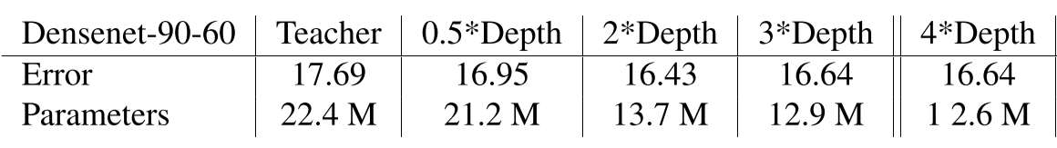
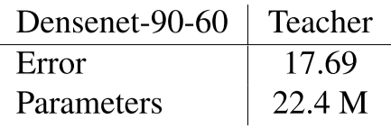
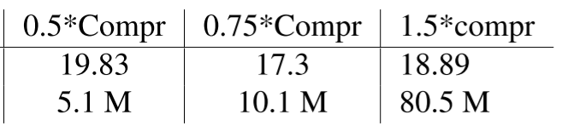
其他实验（student参数不同）
CIFAR-100

Slide 14
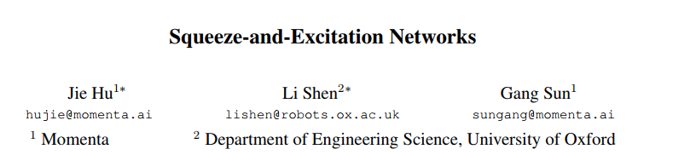
Winner Network of IMAGENET ILSVRC2017
& its pplication in Person Re-identification

Slide 15
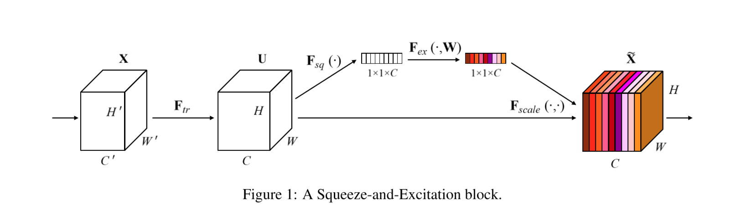
Squeeze-and-Excitation Network (SENet)

Slide 16
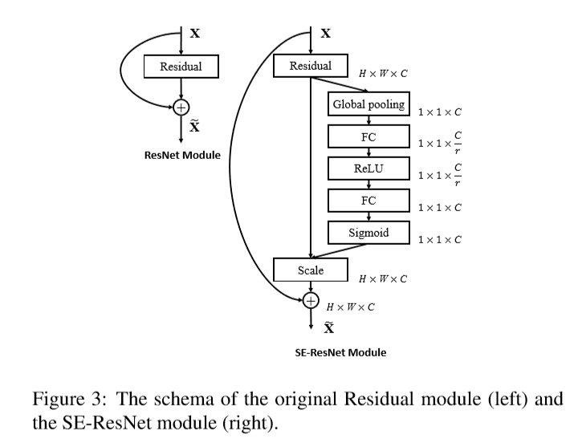
Squeeze-and-Excitation Network (SENet)

Slide 17
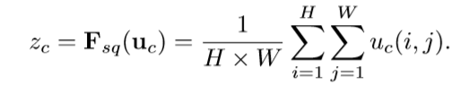

Squeeze-and-Excitation Network (SENet)
Squeeze
Excitation

Slide 18
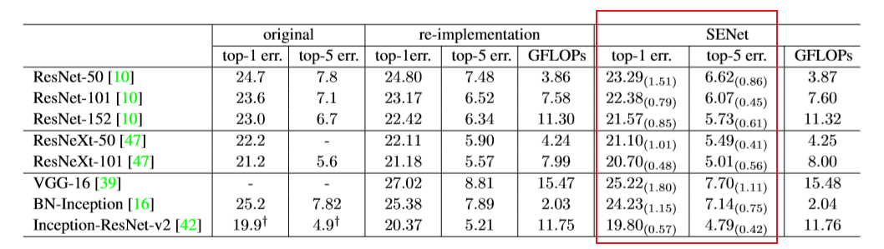
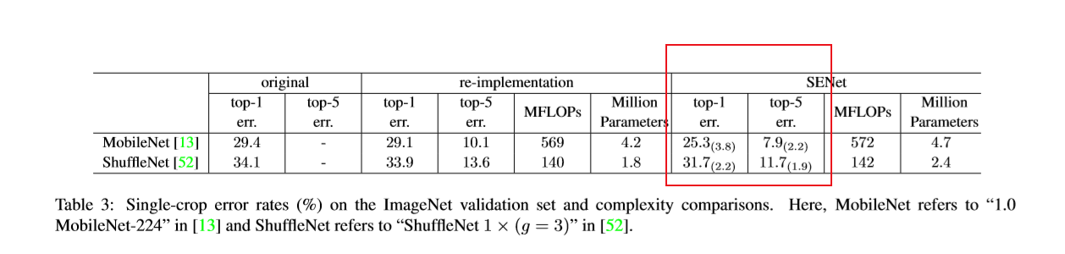
SENet performance

Slide 19
SE Performance on MARKET1501
Model | ACC-128 | MAP-128 | ACC-256 | MAP-256 | ACC-512 | MAP-512 | GPU Speed
Resnet50 | 75.7 | 55 | 77.8 | 55.2 | 76.8 | 53.6 | 879
SE-Resnet50 | 77.2 | 56.4 | 77.8 | 56.1 | 79.3 | 57.3 | 688

Slide 20
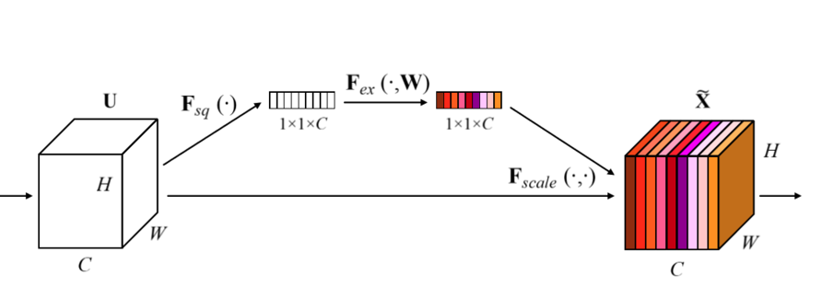
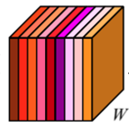



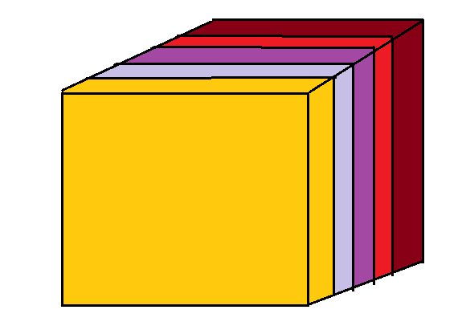








My Idea: Group Squeeze-and-Excitation (GSE)
Channel Attention
$$F_{\text{squeeze}}$$
$$F_{excite}$$
scale
Height Attention
$$F_{\text{squeeze}}$$
$$1×1×H$$
$$1×1×H$$
$$F_{excite}$$
scale
Width Attention
$$1×1×W$$
$$1×1×W$$

Slide 21
Group-SE Performance on MARKET1501
Model | ACC-128 | MAP-128
Resnet50(baseline) | 75.7 | 55
Width-GSE-Resnet50 (x4) | 76.8 | 55.9
Height-GSE-Resnet50 (x4) | 76.3 | 54.7
Width-GSE + SE-Resnet50 | 77.0 | 55.3
SE-Resnet50 (/16) | 77.2 | 56.4
Conclusion: GSE help improve model accuracy useful yet need further investigation

Slide 22
Tiny Networks Performance on Market1501
Model | ACC-128 | ACC-256 | ACC-512 | GPU Speed
1.0 MobileNet | 73.2 | 74 | 76.5 | 1939
1.0 MobileNetV2 | 72.1 | 74.3 | 73.2 | 1662
ShuffleNet v1 1x | 73.6 | 73.8 | 74.5 | 1893
ShuffleNet v1 2x | 75.1 | 76.3 | 76.7 | 1254
ShuffleNet v2 1.5x | 70.1 | 74 | 73.4 | 1900
ShuffleNet v2 2x | 72 | 74.3 | 74.5 | 1632
Resnet18 | 74.5 | 76 | 76 | 2560

Slide 24
Modification in network test on MARKET-1501
Model | ACC-128 | MAP-128
Resnet-18 | 74.5 | 53.5
Resnet-50 | 75.7 | 55
Resnet-101 | 76.5 | 55.4
SE-Resnet50 | 77.2 | 56.4
MS_Resnet50 | 78.7 | 58
MS_SE-Resnet50 | 80.7 | 61.5

Slide 26
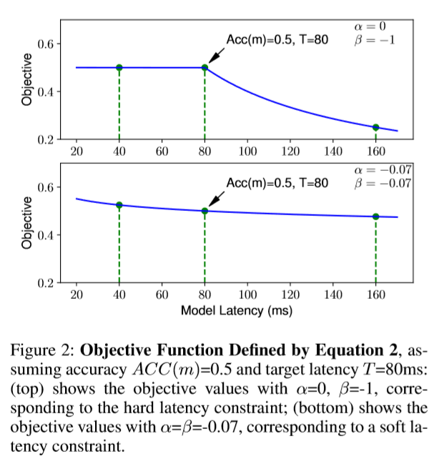
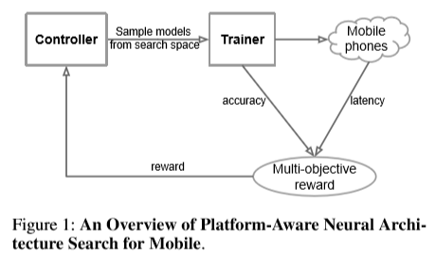
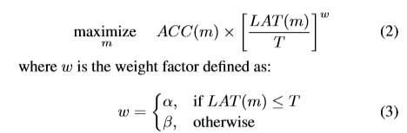

Slide 27
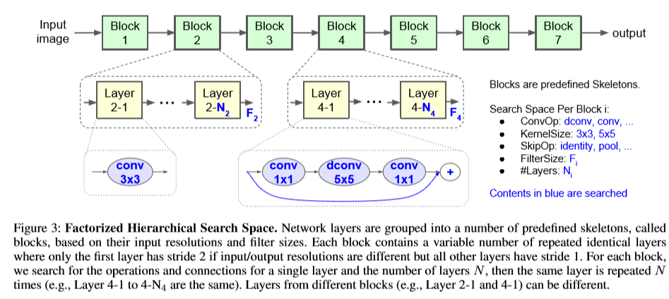
搜索空间：
卷积类型（ConvOp）: regular conv (conv), depthwise conv (dconv), and mobile inverted bottleneck conv with various expansion ratios
卷积内核 KernelSize: 3x3, 5x5.
跳跃层连接方式 SkipOp: max or average pooling, identity residual skip, or no skip path.
输出滤波器尺寸 Output filter size Fi
每个 block 卷积层个数 Number of layers per block Ni.
ConvOp, KernelSize, SkipOp, Fi 决定每一卷积层架构，而 Ni 决定每一个 block 重复卷积层的次数。

Slide 28
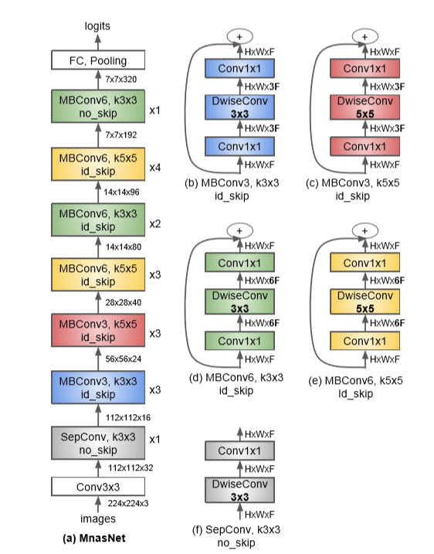
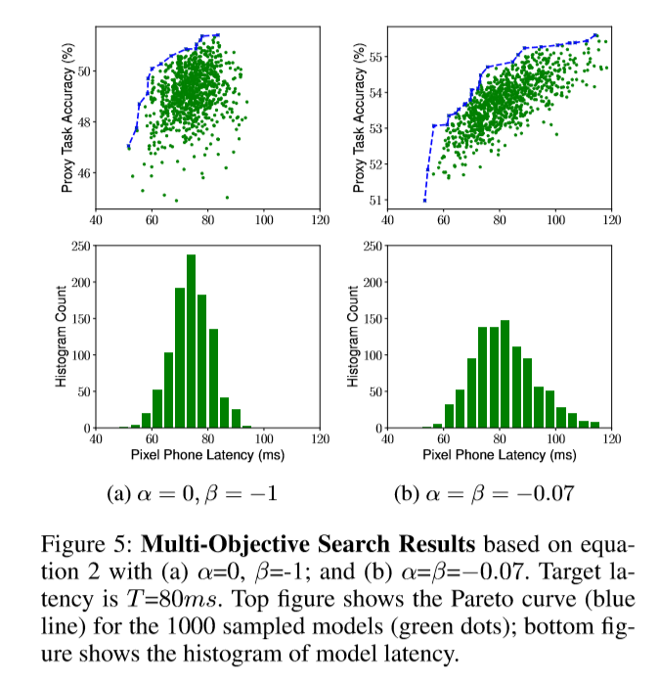

Slide 29
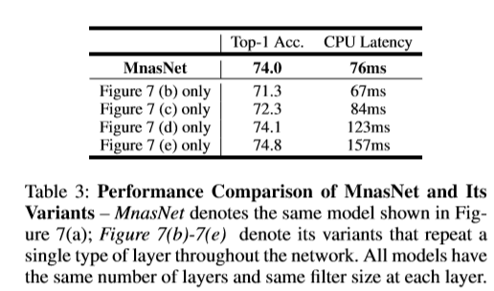
Notes:
r

Slide 30
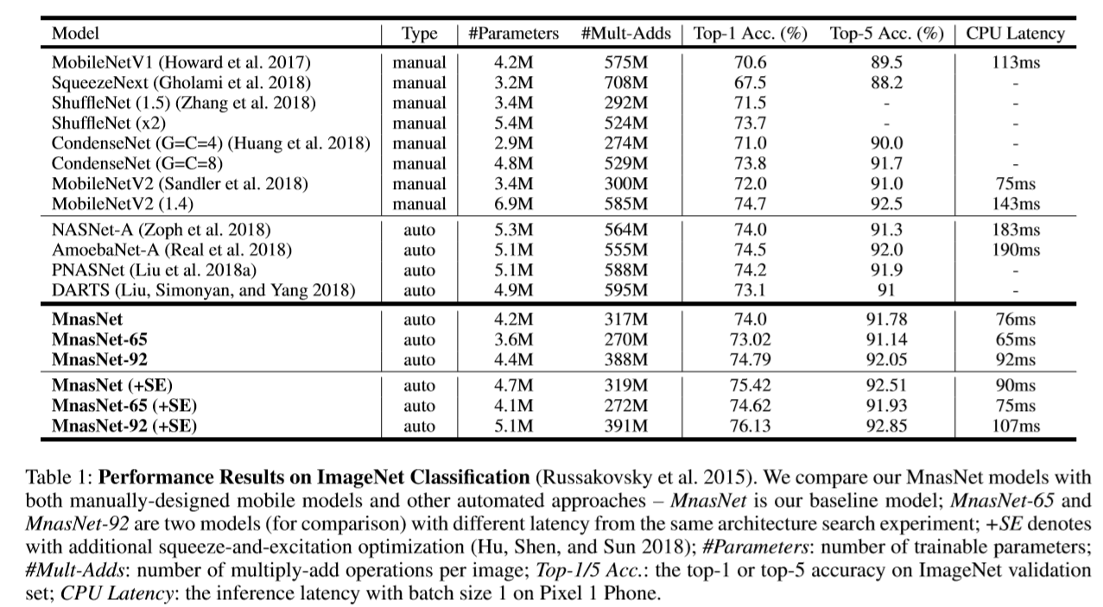
Notes:
r

Slide 31
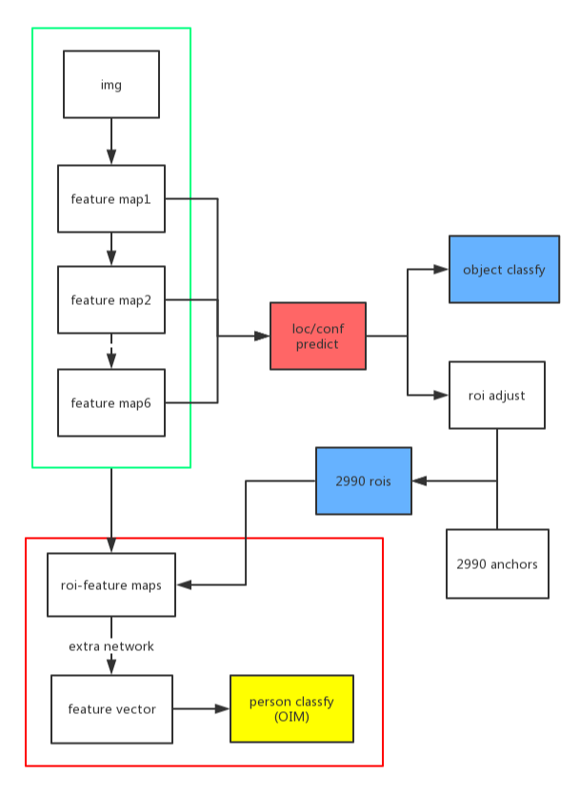
Joint Detection and Identification Feature Learning for Person Search
Mobilenet+SSD on pytorch
Add extra network
Re-forward

Slide 32
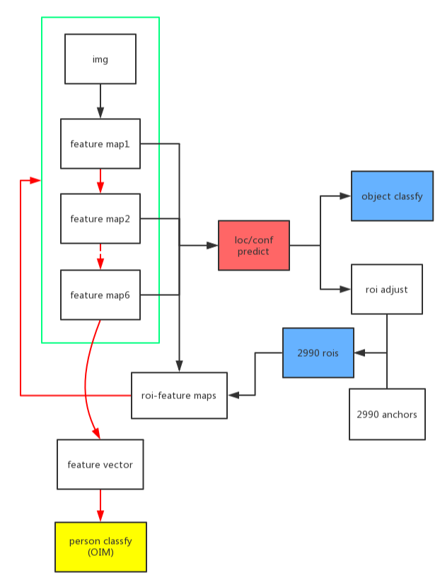
Joint Detection and Identification Feature Learning for Person Search
Mobilenet+SSD on pytorch
Add extra network
Re-forward

